Slide 1
WELCOME

Slide 2
ABOUT GLASSROOTS
​Since 2001, serving the youth and young adults of Newark through the transformative power of the glass-art experience.

Slide 3
HONOREE
Jerry Gottesman
Steadfast Supporter of GlassRoots

Slide 4
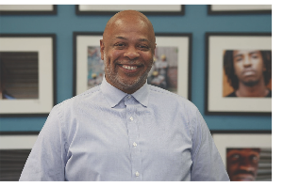
HONOREE
Robert Clark
Youth Workforce Development Champion

Slide 5
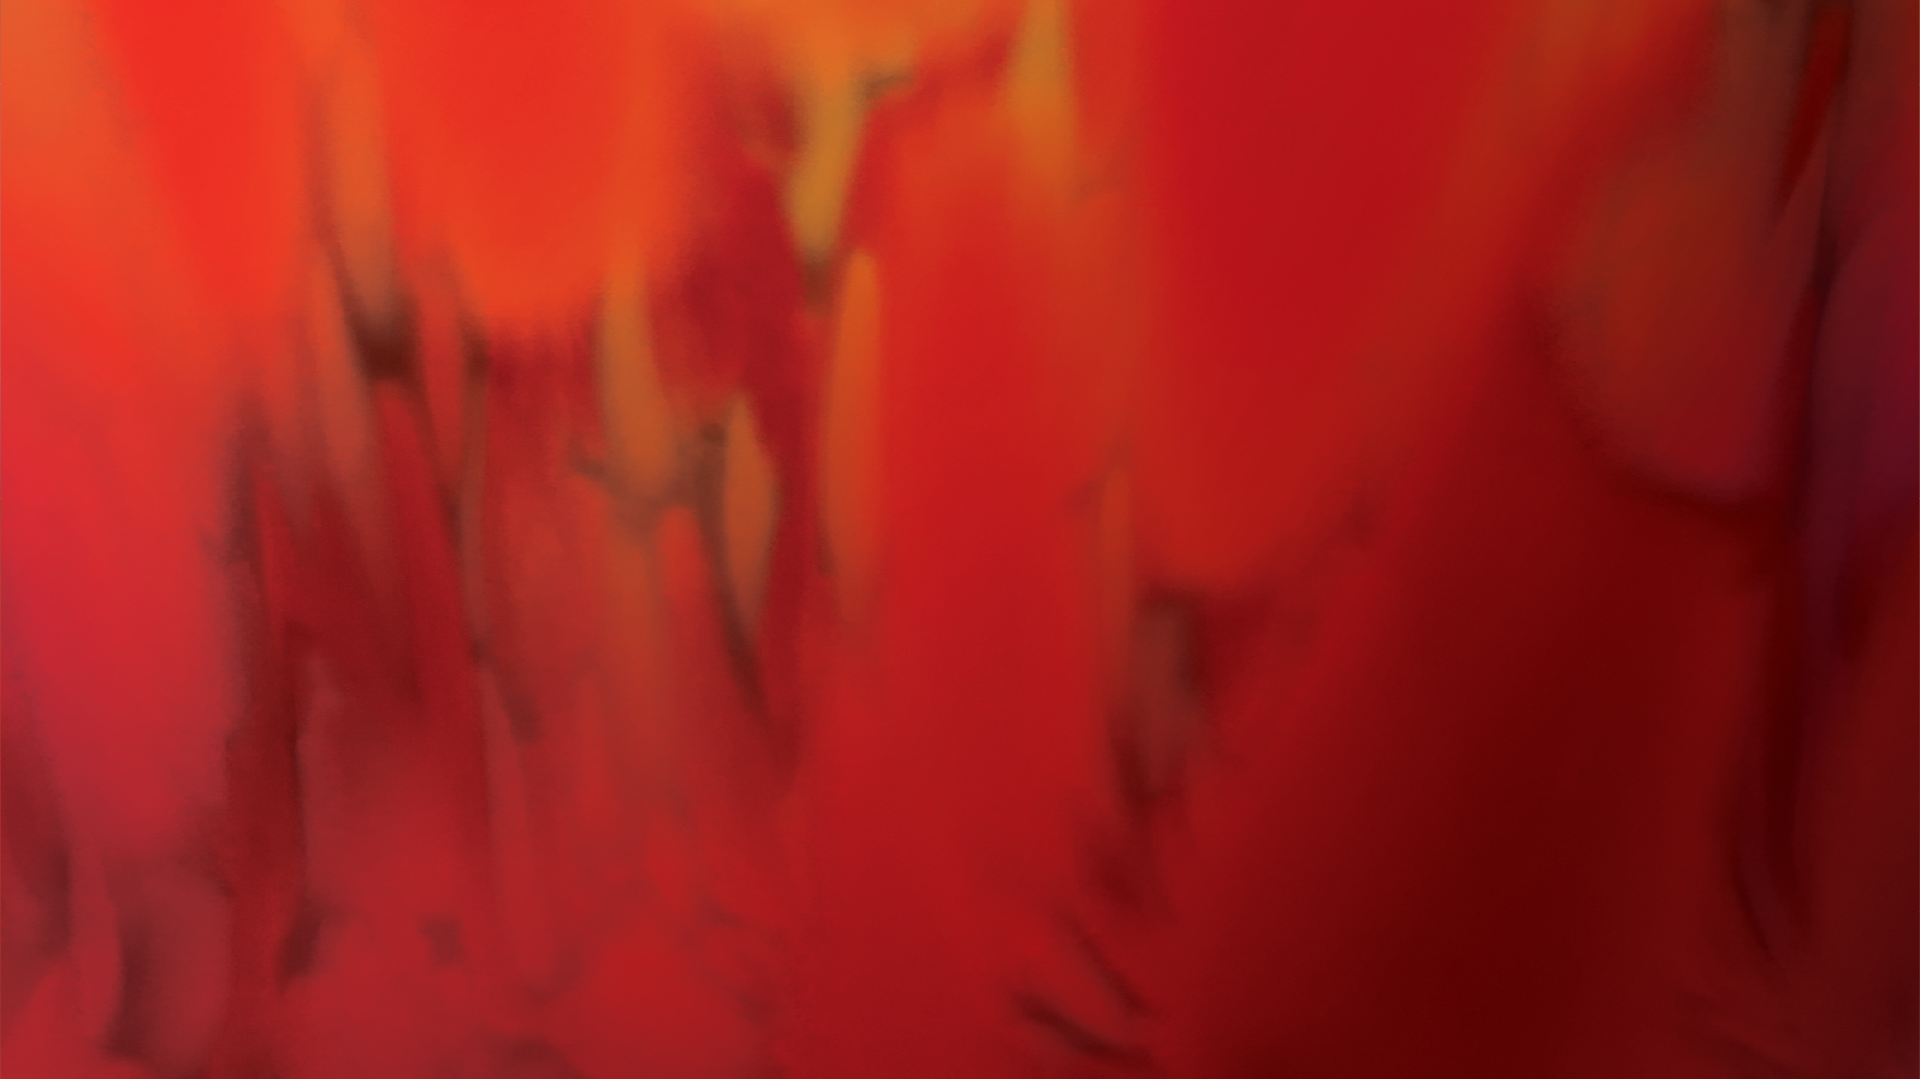
Jerry loved GlassRoots!
Best wishes for continued growth and success.
The Gottesman Family

Slide 12
Congratulations to the
honorees and
the GlassRoots team!
Roger C. Tucker, III, President
Phil Smith, Vice President
Mary C. Jaffa, Treasurer
Dena Lowenbach, Secretary
Sherri-Ann Butterfield Michael Handler Sanaz Hojreh
Karen Howell Ken Press Henry Robinson
William Simpson Veda Truesdale

Slide 13
Congratulations to the
Board and Staff of GlassRoots!
Meg and Howard Jacobs

Slide 14
Wishing the GlassRoot team
Continued Success!
Ferrous Research & Design LLC
casting.finishing.fabrication.
restoration.design.installation
JRAL LLC. an art logistics company
JRAL.com

Slide 15
Congratulations and thanks to all who made tonight possible!
Seta Nazarian

Slide 17
Congratulations to the
Gottesman Family and
Robert Clark!
Nina and Ted Wells

Slide 20
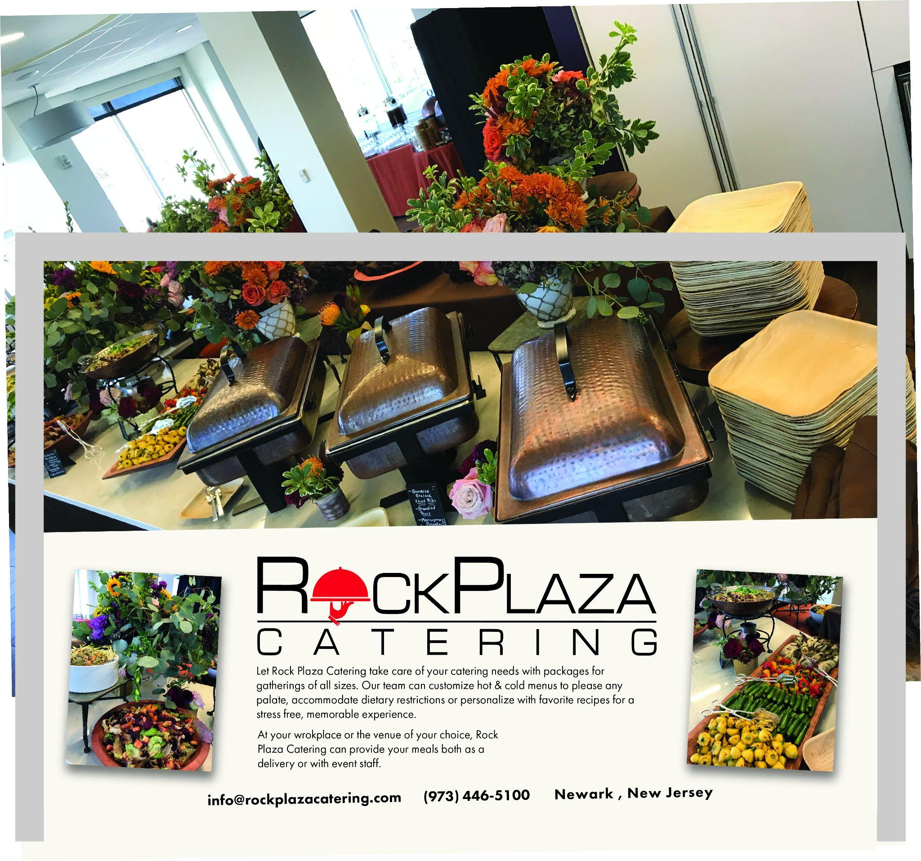

Slide 25
Congratulations to the Gottesman Family, Robert Clark and the GlassRoots team
Ralph and Dena Lowenbach

Slide 28
Lori Lesser and Daniel Shuchman
are proud to support GLASSROOTS

Slide 30
Wishing GlassRoots
a strong future
from the M&T Weiner Foundation
Congratulations GlassRoots!
You are changing lives every day.
Sharon Karmazin

Slide 31
Wishing GlassRoots
a strong future
from the M&T Weiner Foundation

Slide 32
Congratulations to Roger Tucker
and to the GlassRoots team!
“Touching Lives…Changing Lives!”
Marc and Roslyn Collins

Slide 33
Many thanks to the Board,
staff, students and supporters of GlassRoots who made our
first GlassBall possible!
Carol Losos and Karen Gonon

Slide 34
IN HONOR OF
JERRY GOTTESMAN
AND HIS CONTRIBUTIONS
TO GLASSROOTS
THANK
YOU
6:00 PM Cocktails & Demonstrations
7:00 PM Dinner & Presentations
at the Hahne Building, 50 Halsey Street

